Slide 1

Marketing
Analytics
Team member:
Evan Long Ma
Xia Yi Huang
Xiao Yang Ren
https://github.com/EvanLongMa/CustomerSegmentationForFastFood

Slide 2
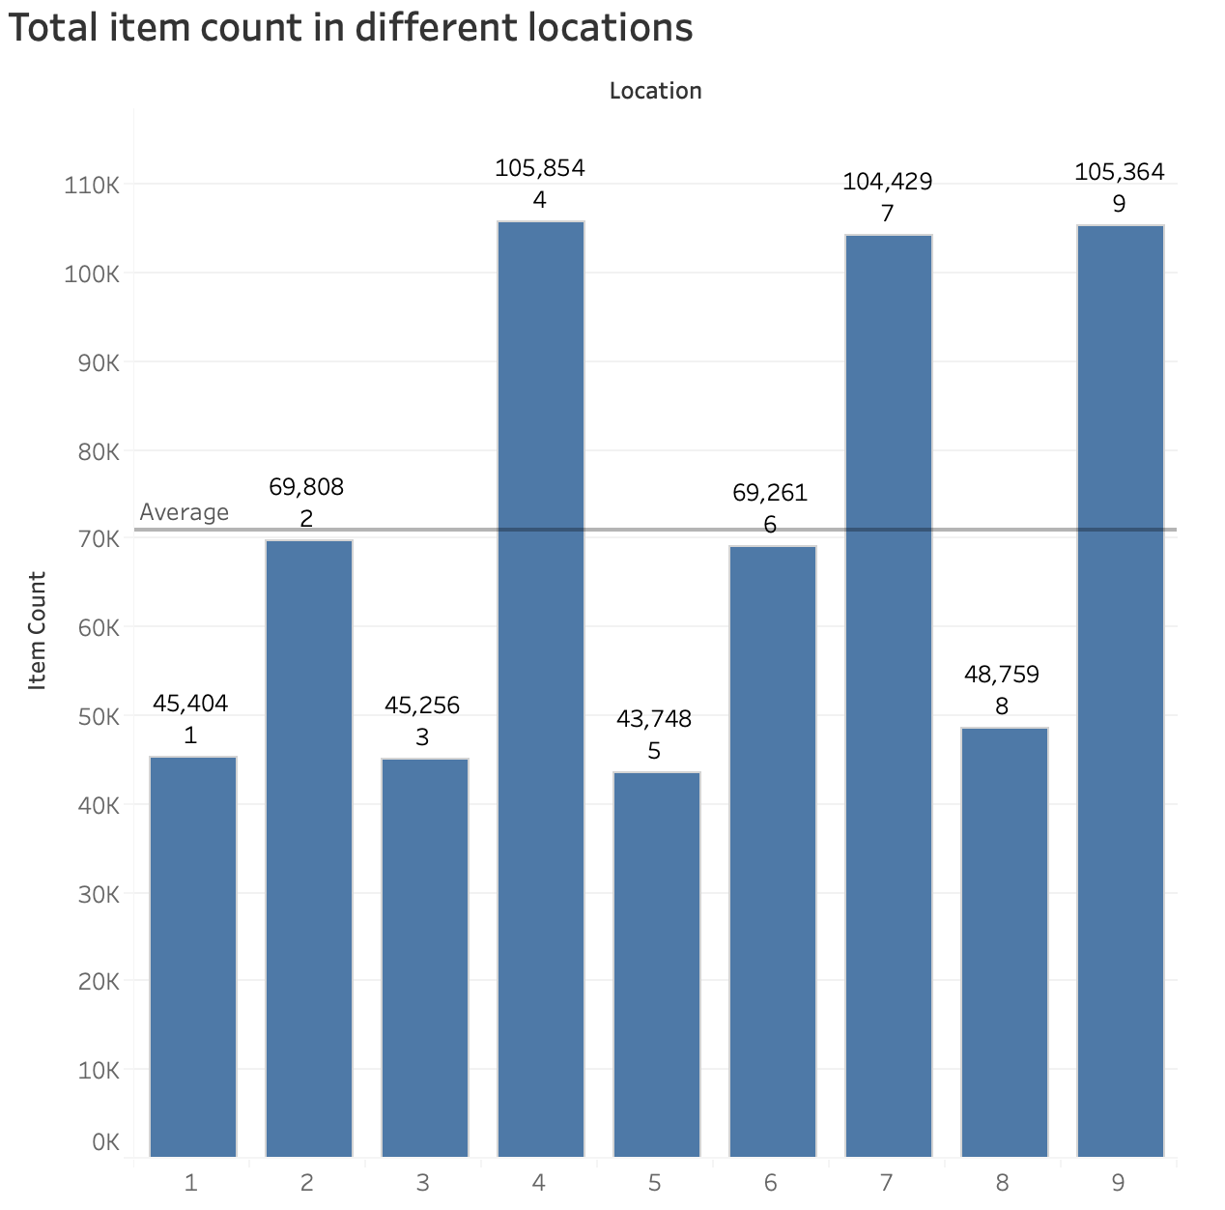
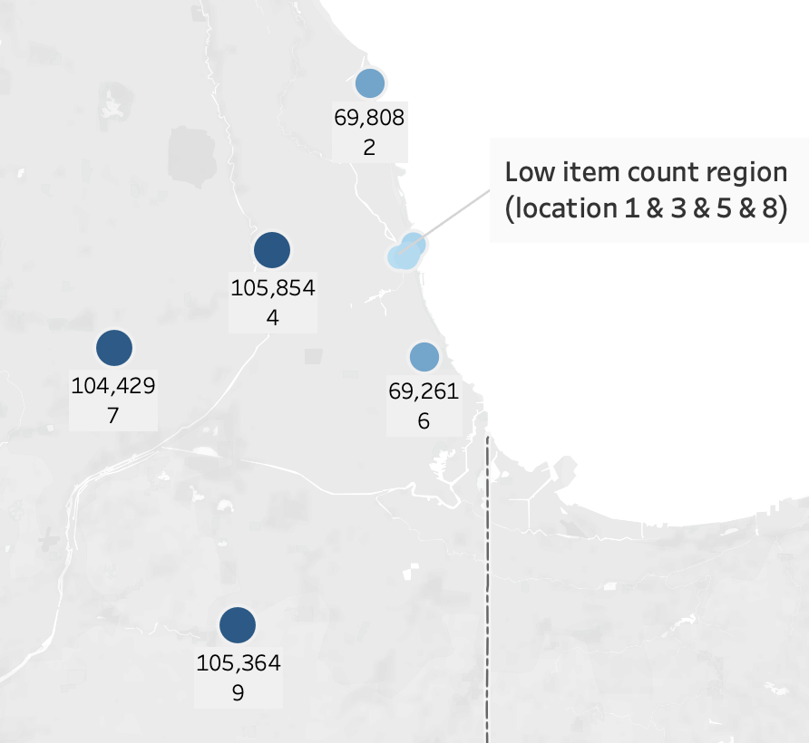
Results and discussion on the clustering model including high level summary of model robustness checks, e.g. how you selected the number of cluster
Descriptive data overview
Low total item count in location 1,3,5,8
High total item count in location 4,7,9

Slide 3
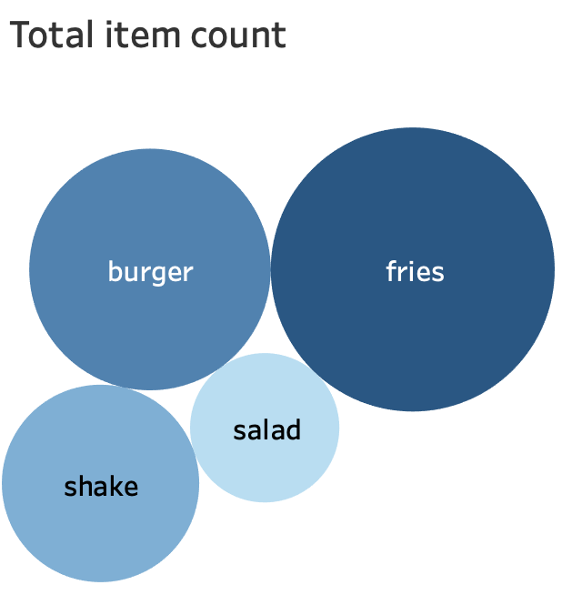
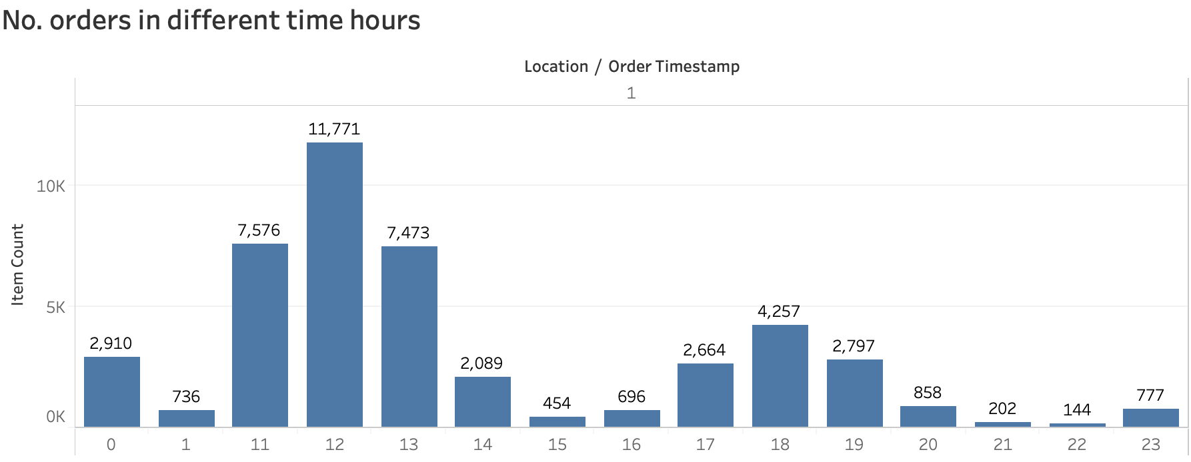
Descriptive data overview
Burger and fries are the two most popular food.
Operating hours:11am-1am
Receive most orders during lunch time

Slide 4
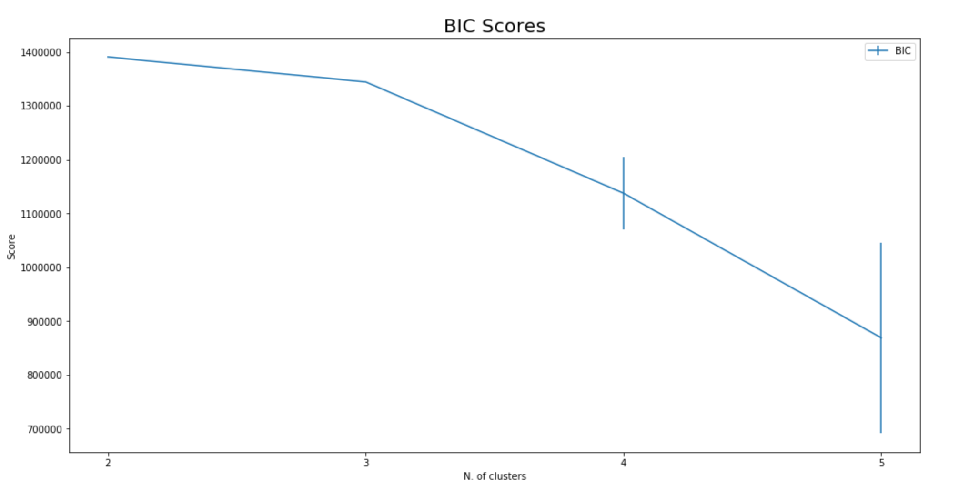
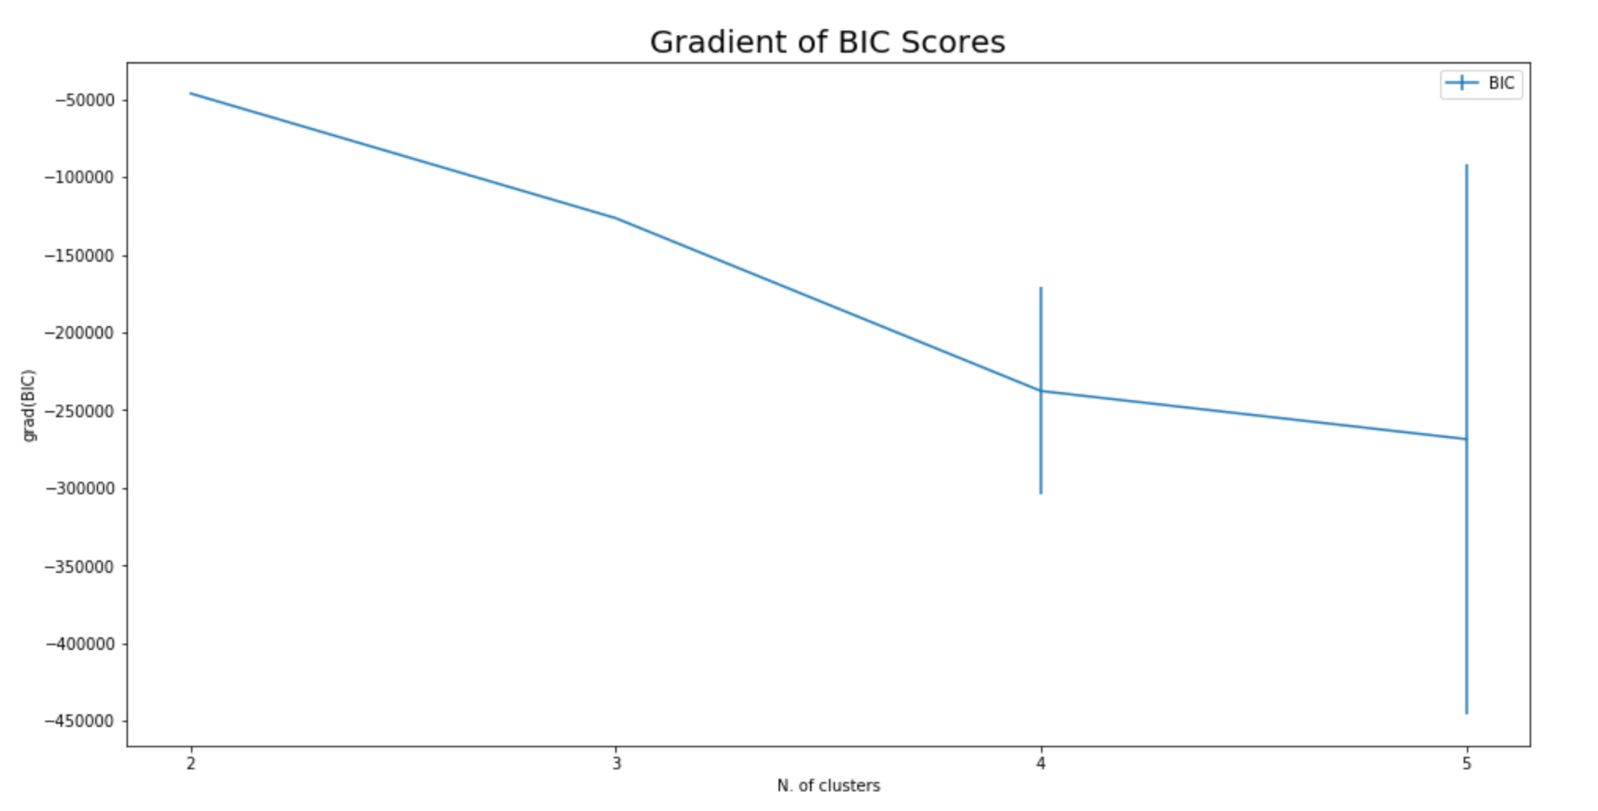
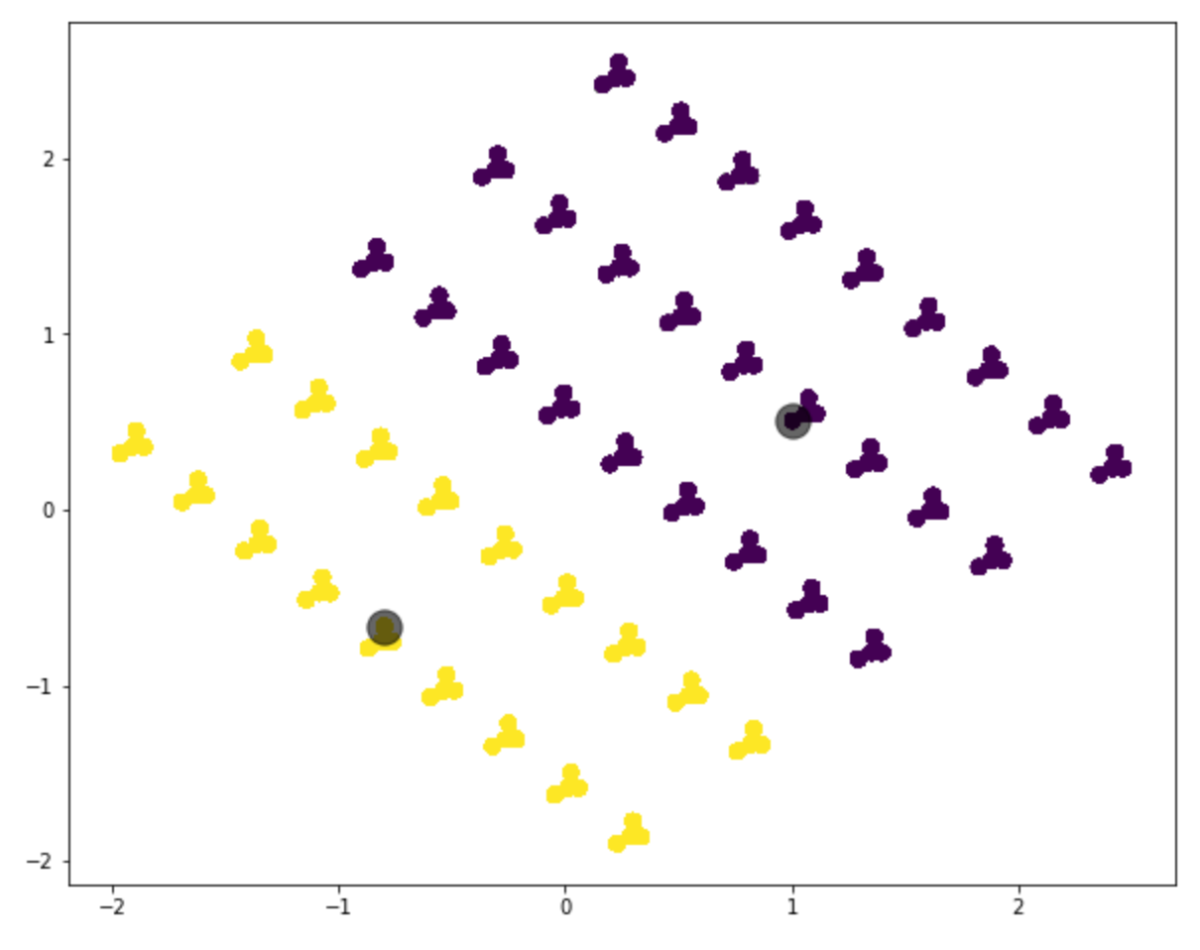
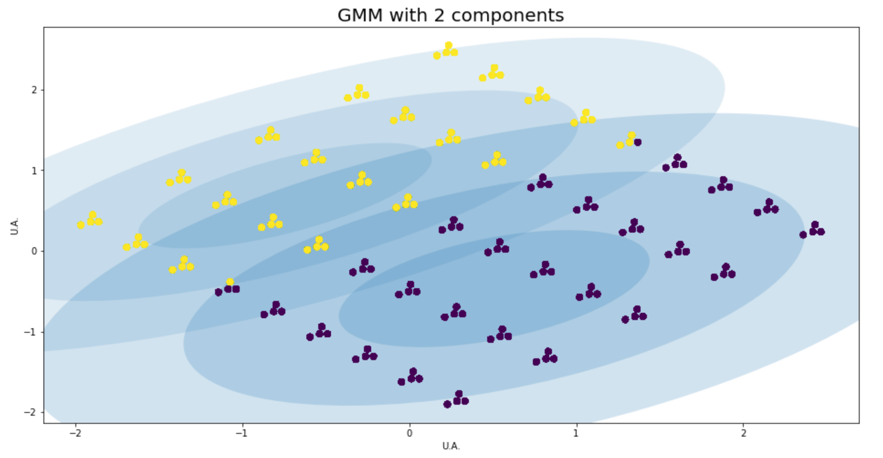
Clustering model

Slide 5

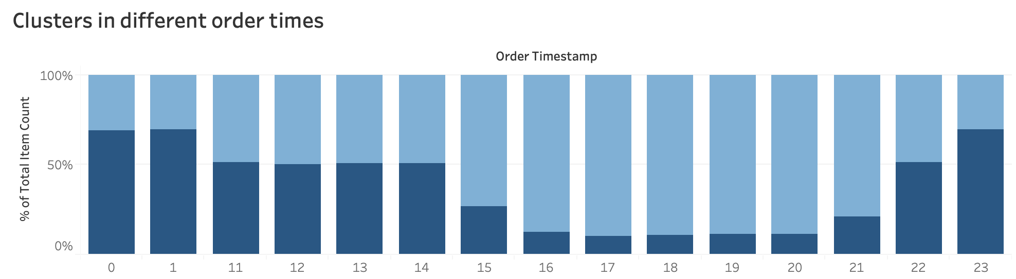
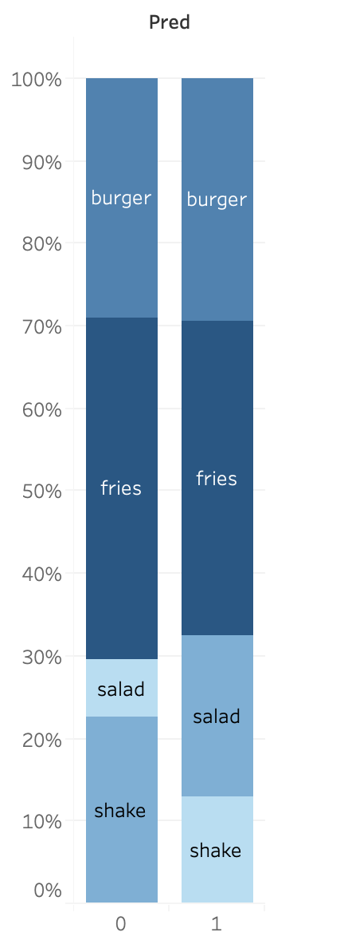
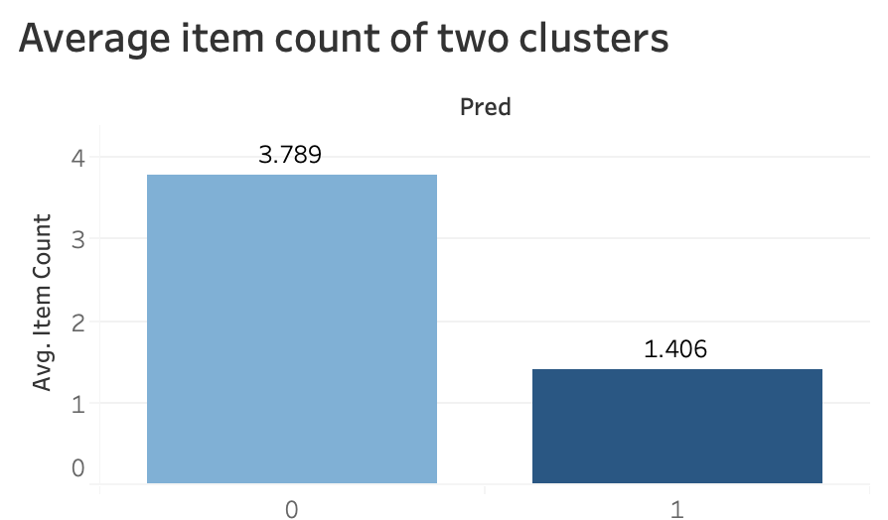
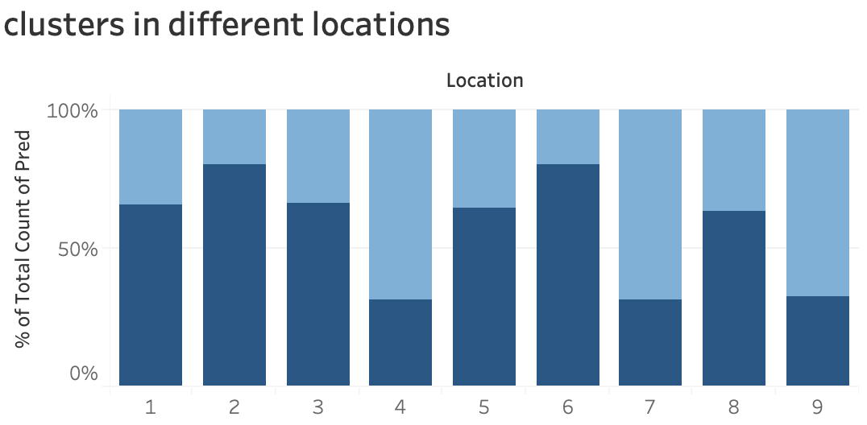
Clustering model
Food types bought

Slide 6


Customer Segment
Time and Location
Time and Location
Value
Value
Time slot preference:3pm-9pm
Location preference:4,7,9
High in expenditure
Time slot preference:10pm-1am
Location preference:1,2,3,5,6,8
low in expenditure
Food Type
Clustering 0
Food Type
Clustering 1
Potential cohort
Burger:29.4%
Fries:38%
Salad:19.5%
Shake:13%
Potential cohort
Burger:29%
Fries:41.3%
Salad:7.1%
Shake:22.6%
Surburb residents: live in surburb, and get fewer choices,focus less on health
Urban residents:have more choices,prefer to order night snacks as many other restaurants are closed as that time, they focus more on health

Slide 7

Which segment is more valuable
Marketing strategy
Product
Method:
Add healthy casual food---poke bowl (e.g.teriyaki chicken poke bowl) and Shake without sugar
Rationale:
Try to attract customers seeking for healthier and more classy food
Position
Method:
Work with takeaway platform (e.g. Uber eat) to expand operation scale
Rationale:
The location 1&3&5&8 is too close to each other
Price
Method:
Loss-leader pricing, we set the fries at low price (cost)
Rationale:
Try to increase total item count and obtain more customers
Clustering 1
Choose clustering 1---urban residents
Why?
Potential Order Capacity
Marginal effect
Clustering 0
(Suburb residents)
LOW
Suburb residents prefer to buy item in location 4,7,9, which already have very high item counts. Therefore these spots may almost reach to the full capacity
LOW
The expenditure of suburb residents is already very high, so the marginal effect of marketing strategy would be low.
Promotion
Method: Give discount to new customers and frequent buyers
Rationale: Try to increase total item count and obtain more customers
Clustering 1
(Urban residents)
High
Urban residents prefer to buy item in the shop located in city area, which have an average 60% total number of item count of the restaurants in Suburb area. So the potential order capacity of urban stores are high
High
The expenditure of urban residents is pretty low, so there’s plenty of room to increase. Therefore, the marginal effect of marketing strategy would be high

